Slide 1


Slide 2
Meet Gremlin
your guide through graphs in Cosmos DB

Slide 3



Rafał Hryniewski
fb.me/hryniewskinet
@r_hryniewski

Slide 4


Slide 5
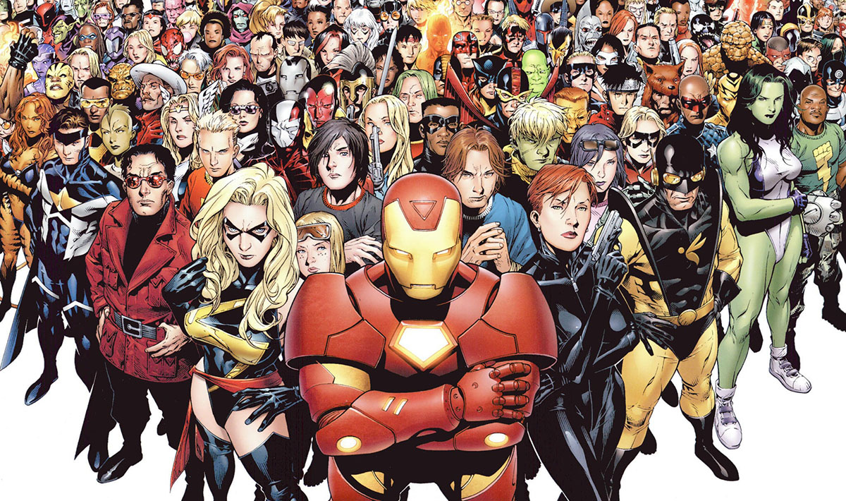

Slide 6
Meet Gremlin
your guide through graphs in Cosmos DB

Slide 7
Agenda
Brief Cosmos DB overview.
Welcome to the world of Graphs.
Meet Gremlin!
Gremlin vs. SQL – Pissing contest.
Demo.
How it works?
Where does Gremlin live?

Slide 8

But what is Cosmos DB?

Slide 9
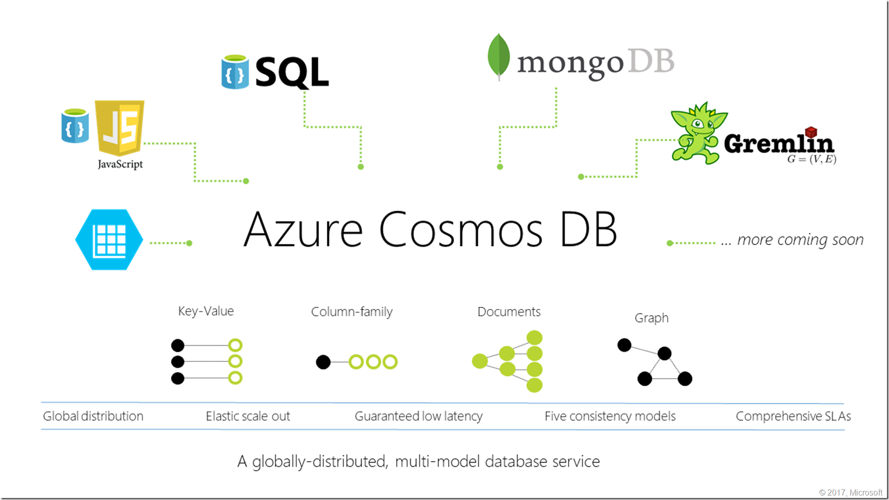

Slide 10

Graph databases

Slide 11
Edges and vertices
Vertex
Vertex
Edge

Slide 12
Edges and vertices
Person
Car
Owns

Slide 13
Property graph
Person
Car
Owns
Name: „John”
Surname: „Smith”
Age: 30
Since: „01-01-2017”
Leased: false
Age: 30
Brand: Jaguar
Series: XJ
Production: 2017
Engine: 5.0
Fuel: LPG

Slide 14
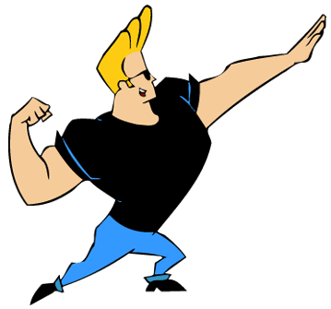
And everything can relate with everything

Slide 15


Slide 16
Scary?

Slide 17
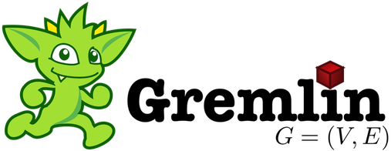
Meet Gremlin!

Slide 18
Gremlin – data format sample (GraphSON)
{"id": "33843a67-0da8-4dde-81ff-eff607882f23",
"label": "59be9f016f12f58cd5eb0cac",
"type": "vertex",
"properties": {
"firstName": [
{
"id": "742b60bd-cd75-4ec1-b288-c694d88c14ed",
"value": "Santana"
}
],
"lastName": [
{
"id": "70ed7300-cc4d-41c4-8af9-ba65445898ee",
"value": "Peters"
}
],
"gender": [
{
"id": "78b124d0-73af-4ff7-8f93-881377086568",
"value": "male"
}
],
"birthday": [
{
"id": "9140a304-a073-4c55-a86f-f3206d4ecbd9",
"value": "2016-08-15T10:10:17 -02:00"
}
],
"project": [
{
"id": "6cc7ffd1-6427-49a0-85c2-e1f5b1bbcd42",
"value": "elit"
}
]}

Slide 19
Gremlin – query samples
g.V('someId')
g.V().hasLabel('person’).out('knows').has('gender', 'female')
g.V().valueMap('firstName', 'lastName’)
G.V('1').out('bought').hasLabel('customer').in('bought').hasLabel('product’).dedup().values('id')

Slide 20
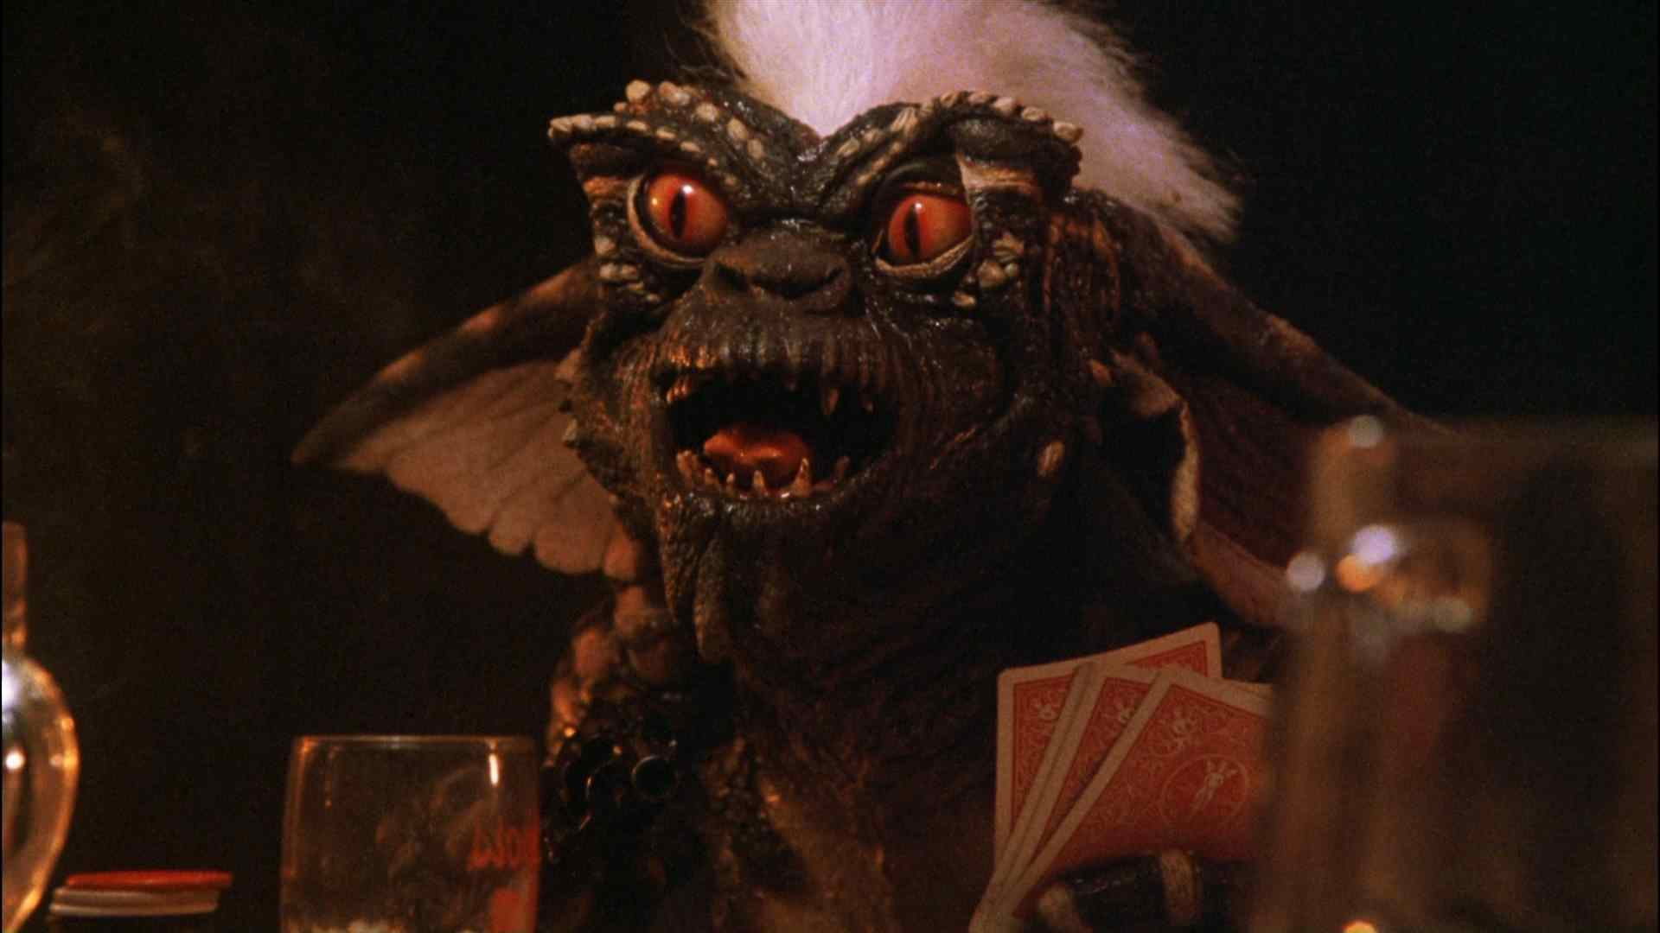
Hey! Wasn’t Gremlin supposed to be our friend?

Slide 21
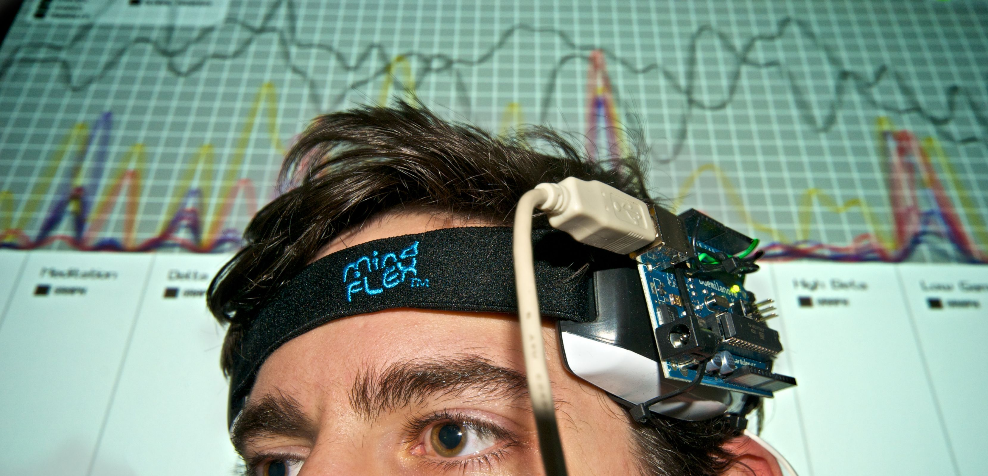
We just need do adjust our brain a little

Slide 22

Imagine modeling one of those in RDBMS

Slide 23
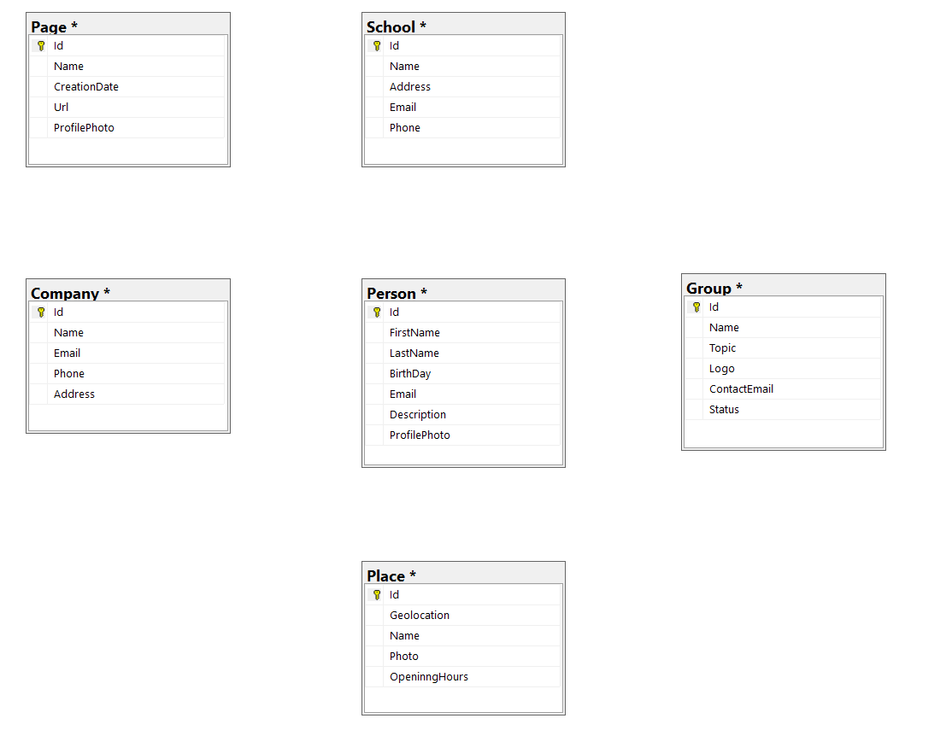
Take some tables...

Slide 24
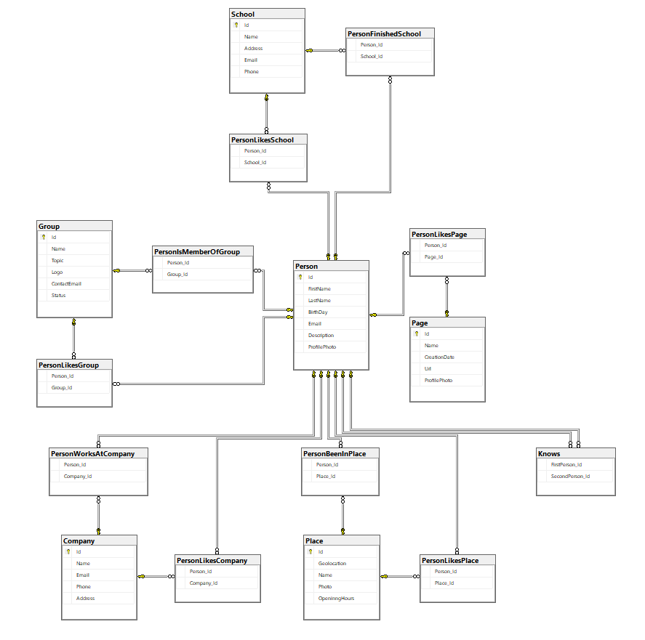
...add a couple of relations...

Slide 25
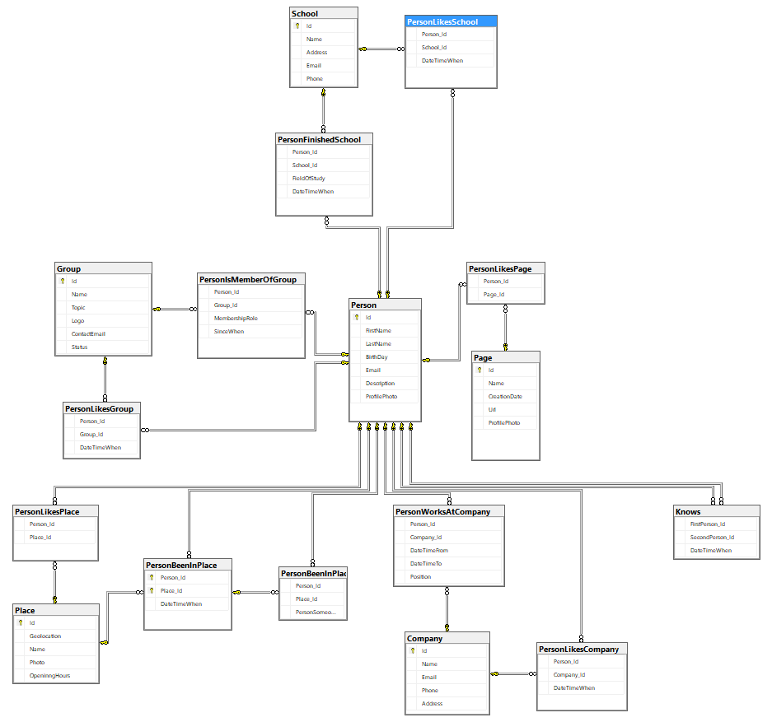
...and some properties to our relations...

Slide 26
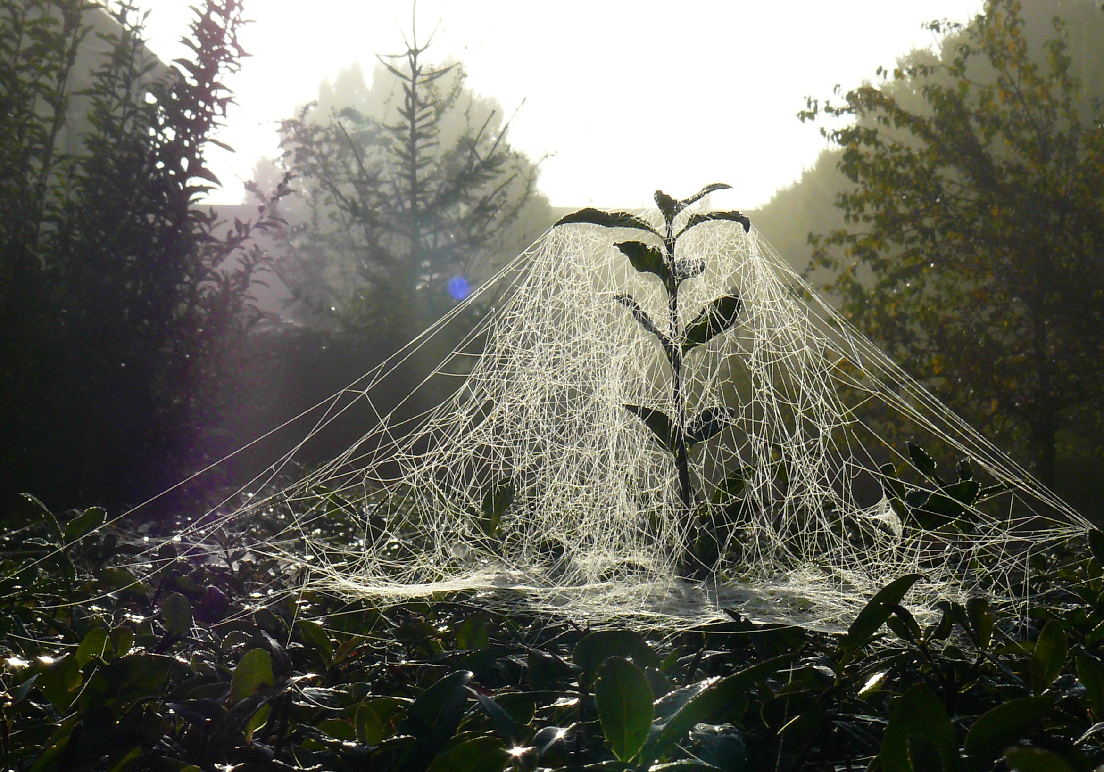
...and so on

Slide 27
What friends of my friends likes the most?
What are names of pages that friends of my friends that finished Computer Science in school liked?

Slide 28
What friends of my friends likes the most?
SELECT DISTINCT friendOfFriendLikedPage.[Name]
FROM [dbo].[Person] person
JOIN [dbo].[Knows] personKnows
ON person.[Id] = personKnows.[FirstPerson_Id]
JOIN [dbo].[Person] friend -- friends
ON personKnows.[SecondPerson_Id] = friend.[Id]
JOIN [dbo].[Knows] friendKnows
ON friend.[Id] = friendKnows.[FirstPerson_Id]
JOIN [dbo].[Person] friendOfFriend --friends of friends
ON friendKnows.[SecondPerson_Id] = friendOfFriend.[Id]
JOIN [dbo].[PersonLikesPage] friendOfFriendPageLikes
ON friendOfFriendPageLikes.[Person_Id] = friendOfFriend.[Id]
JOIN [dbo].[Page] friendOfFriendLikedPage --pages they liked
ON friendOfFriendLikedPage.[Id] = friendOfFriendPageLikes.[Page_Id]
JOIN [dbo].[PersonFinishedSchool] friendOfFriendFinishedSchool --schools finished
ON friendOfFriendFinishedSchool.[Person_Id] = friendOfFriend.[Id]
WHERE friendOfFriendFinishedSchool.[FieldOfStudy] = 'Computer Science' AND person.[Id] = 1

Slide 29
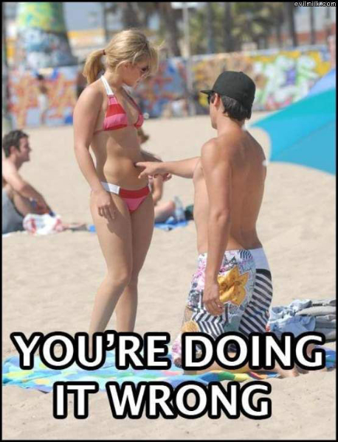

Slide 30
What friends of my friends likes the most?
g.V("1").out("knows") //friends
.out("knows") //friends of friends
.where( //finished schools
outE("finishedSchool").has("fieldOfStudy", "Computer Science"))
.out("liked").hasLabel("page") //page they liked
.values("name")

Slide 31
What friends of my friends likes the most?
Id:1
Knows
Person
Knows
Person
Liked
Page
Name
Field of study = „Computer Science”
Finished school
School

Slide 32
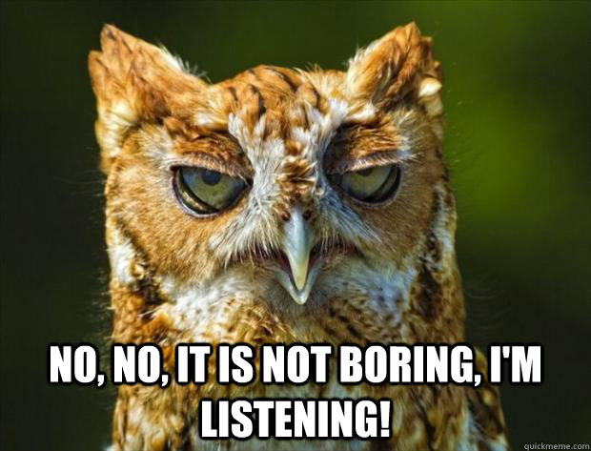
Enough talking, let’s do stuff!

Slide 33
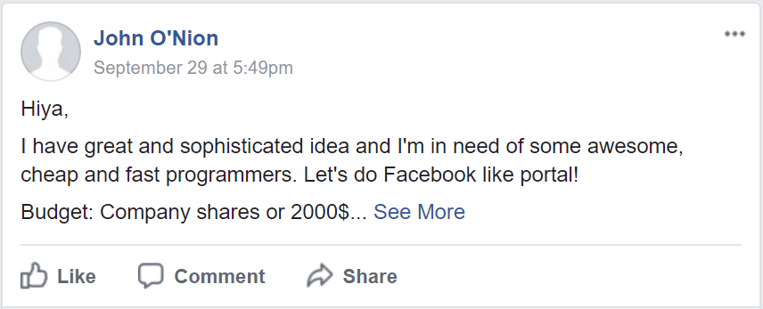

Slide 34

Easy money!

Slide 35
Demo - bit.ly/grembook
You’ll need to login with Facebook
I’ll use only your id, name, last name, and profile picture url
Data will be deleted after talk

Slide 36


Slide 37
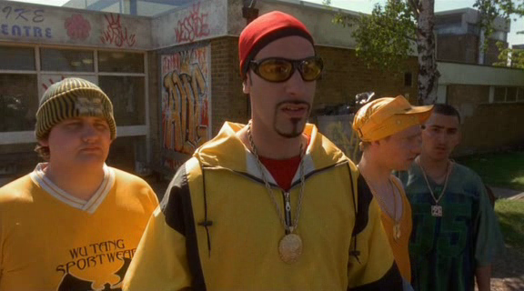
What does g. stands for?

Slide 38
g.
g. = GraphTraversalSource
It’s starting point of our traversal
We can follow with V or E to start traversing our graph from Vertices or Edges respectively

Slide 39
Who are the users that are friends of my friends?
g.V('myId’) .bothE('friend').otherV() .bothE('friend').otherV()
.hasLabel('user') .dedup()

Slide 40
Who are the users that are friends of my friends?
g.V('myId’) .bothE('friend').otherV() .bothE('friend').otherV()
.hasLabel('user') .dedup()

Slide 41
Who are the users that are friends of my friends?
g.V('myId') .bothE('friend').otherV() .bothE('friend').otherV()
.hasLabel('user') .dedup()

Slide 42
Who are the users that are friends of my friends?
g.V('myId') .bothE('friend').otherV() .bothE('friend').otherV()
.hasLabel('user') .dedup()

Slide 43
Who are the users that are friends of my friends?
g.V('myId') .bothE('friend').otherV() .bothE('friend').otherV()
.hasLabel('user') .dedup()

Slide 44
... myself excluded
g.V('myId’)
.as('me') .bothE('friend').otherV() .bothE('friend').otherV()
.hasLabel('user') .where(neq('me'))

Slide 45
... myself excluded
g.V('myId’)
.as('me') .bothE('friend').otherV() .bothE('friend').otherV()
.hasLabel('user') .where(neq('me'))

Slide 46
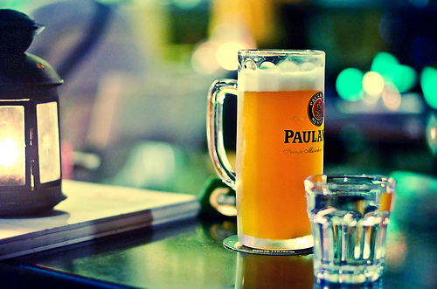
Another one?

Slide 47
Where does people that attended to Harvard University work?
g.E().hasLabel('attended')
.where(
inV().hasLabel('school')
.has('name', 'Harvard University'))
.outV()
.out('worksAt')
.dedup().values('name')

Slide 48
Where does people that attended to Harvard University work?
g.E().hasLabel('attended')
.where(
inV().hasLabel('school')
.has('name', 'Harvard University'))
.outV()
.out('worksAt')
.dedup().values('name')

Slide 49
Where does people that attended to Harvard University work?
g.E().hasLabel('attended')
.where(
inV().hasLabel('school')
.has('name', 'Harvard University'))
.outV()
.out('worksAt')
.dedup().values('name')

Slide 50
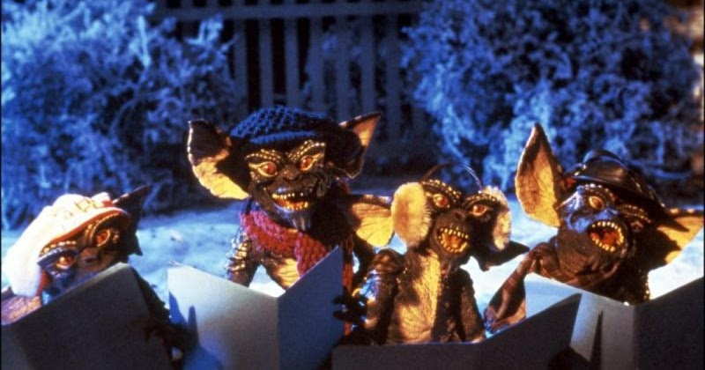
Other graph databases with Gremlins inside

Slide 51
Other graph databases with Gremlins inside
Neo4j
Titan DB
JanusGraph

Slide 52
Links
Demo app repository
https://github.com/r-hryniewski/Graphbook
Gremlin Quickstart
http://tinkerpop.apache.org/docs/current/tutorials/getting-started/
Gremlin Documentation
https://db-engines.com/en/ranking
CosmosDB try for free
https://azure.microsoft.com/en-us/try/cosmosdb/
CosmosDB documentation
https://docs.microsoft.com/en-us/azure/cosmos-db/
CosmosDB implemented Gremlin features
https://docs.microsoft.com/en-us/azure/cosmos-db/gremlin-support

Slide 53
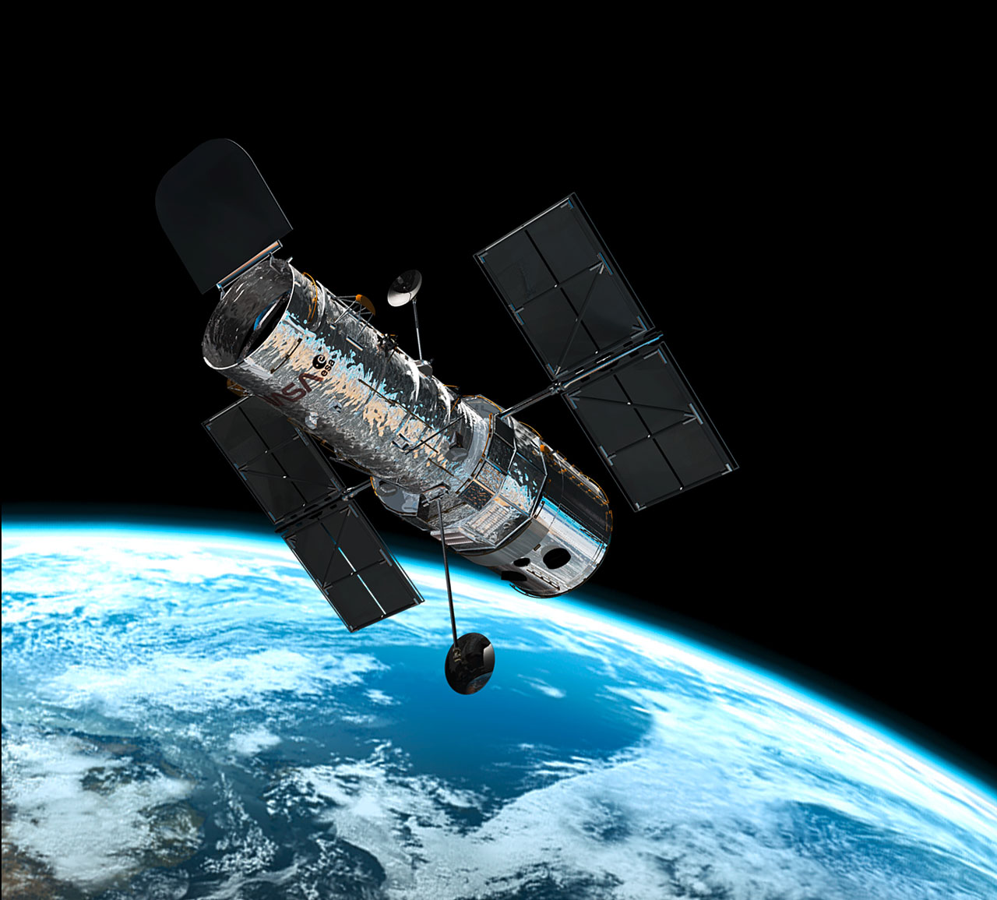
Questions?

Slide 54
Let’s grab a beer and talk about it in a few moments!
fb.me/hryniewskinet
@r_hryniewski

